Slide 1
Python
File I/O and Exception handling
By – Rageeni Sah
sahrageeni4@gmail.com

Slide 2
Why files I/O knowing important?
To read/write important details
To modify existing files through programming
To store/track logs

Slide 3
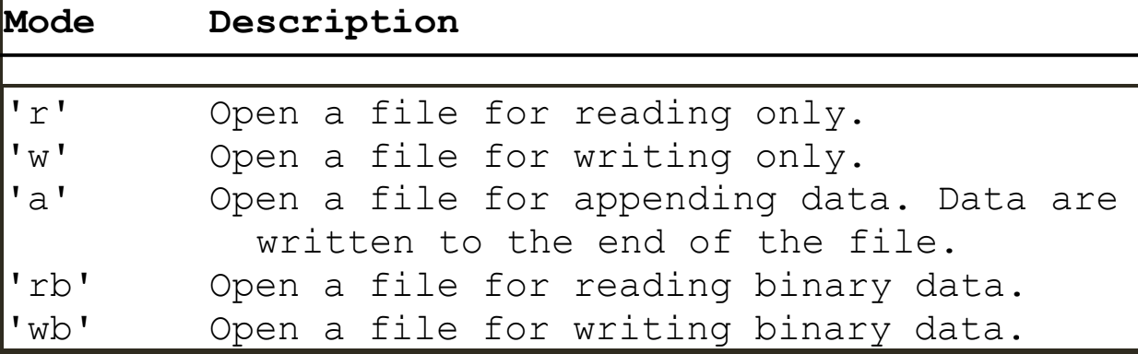
Open a file
<file_object> = open(filename, mode)

Slide 4
Write to a file
outfile = open(‘test.txt’,’w’)
Outfile.write(‘Welcome to python’)

Slide 5
Read from a file
outfile = open(‘test.txt’,’w’)
Readline(outfile) # reads all the lines
readline(outfile). # reads next line
readlines(outfile) # reads all the lines in the file but each line is represented as an element of the list

Slide 6
Append data to a file
outfile = open(‘test.txt’,’a’)
Outfile.write(‘Appending data to the file’)
‘a’ – appends data to the existing data

Slide 7
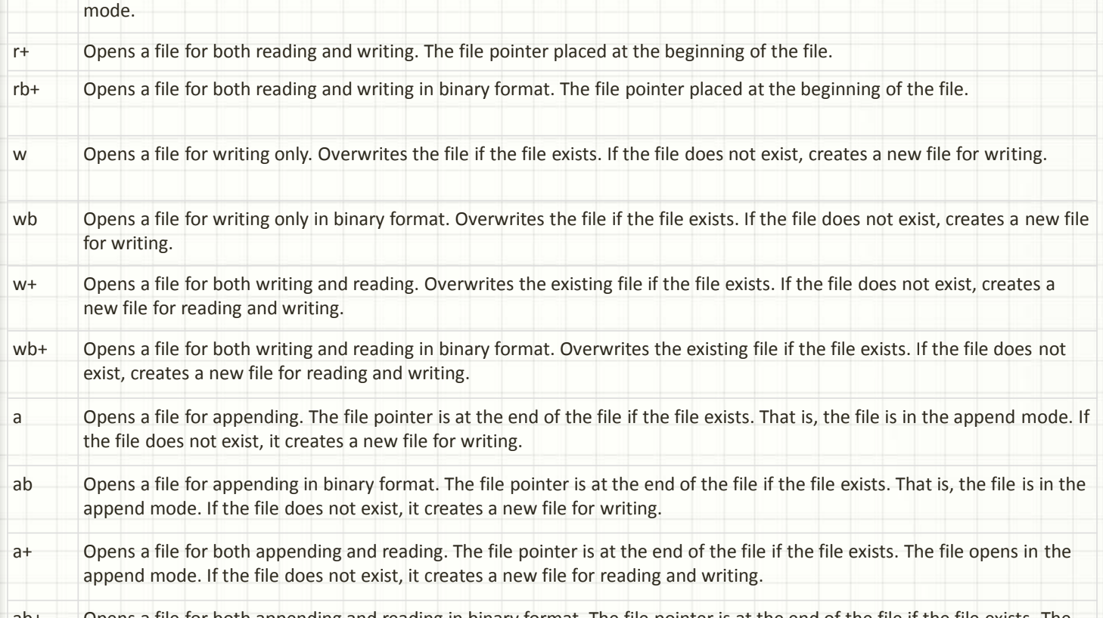

Slide 8
Retrieving data from the web
Sample code:
Import urllib.request
Infile = urllib.request.urlopen(‘http://www.yahoo.com’)
Print(infile.read().decode())

Slide 9
Exceptions handling

Slide 10
Errors in python
There are 3 types of errors in python:
Syntax errors – detected during syntax parsing
Logical errors – detected during bugs fixing
Exceptions - occurs at run-time
Last errors are detected during run-time and program stops current execution if not handled properly

Slide 11
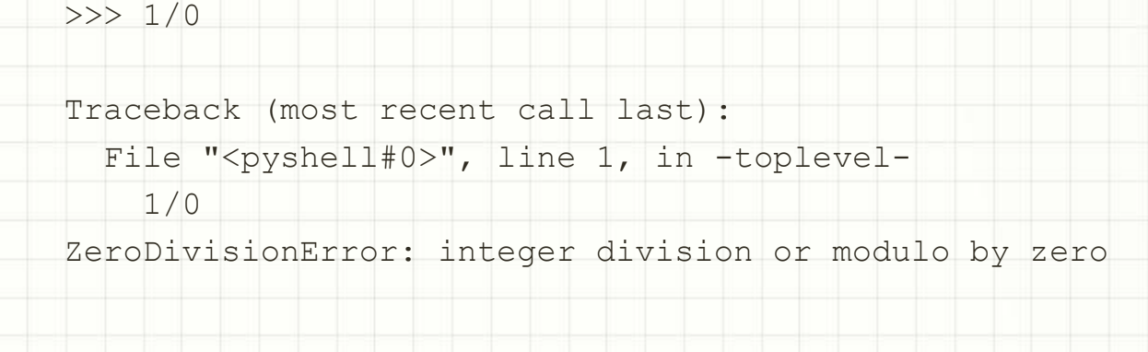
Example of an Exception

Slide 12
Handling Exceptions
The most basic way to handle an exception is to use the python “try” and “except” clause
Example
  Try:
    Num = int(‘Enter a number) ### try to execute this block first
    Except:
    Print(‘something went wrong’). ### print this message if any error in executing try block
    Finally:
    <irrespective of above two – execute this block>

Slide 13
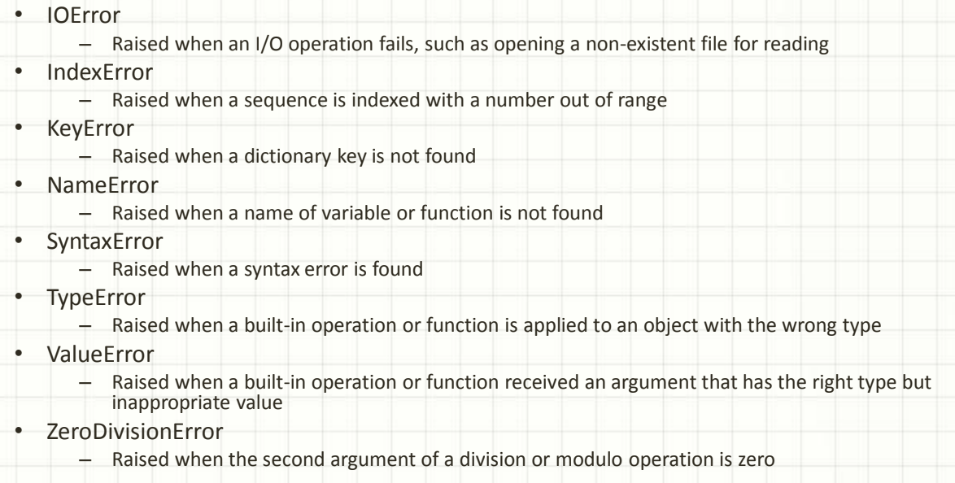
Exceptions type

Slide 14
Multiple except blocks
Multiple except blocks can be used. The matching one gets executed.
try:
a = 5
b = 0
num = int(input("enter an integer:"))
print(a/b)
except TypeError as e:
print(e)
except ZeroDivisionError as f:
print (f)
except Exception:
print('something went wrong')

